Slide 1



Critical Section Protection

Slide 2
What is a race condition?
The result of software execution is dependent upon order of execution
  Requires a shared resource, (generally shared memory)
  Requires at least two “concurrent” lines of execution (i.e. processes or threads)
    One might even be an ISR
  Each process or thread accesses the shared resource
  The order in which the concurrent operations occur change the result of logic

Slide 3


Let’s model a bank ATM (correct order)
float bal = fetchBalance();
bal -= 100;
dispenceCash(100);
setBalance(bal);
TIME
$1000
$900
float bal = fetchBalance();
bal -= 100;
dispenceCash(100);
setBalance(bal);
$900
$800

Slide 4
Let’s model a bank ATM (incorrect order)
$1000
$1000
$900
TIME
$900
float bal = fetchBalance();
bal -= 100;
dispenceCash(100);
setBalance(bal);
float bal = fetchBalance();
bal -= 100;
dispenceCash(100);
setBalance(bal);

Slide 5
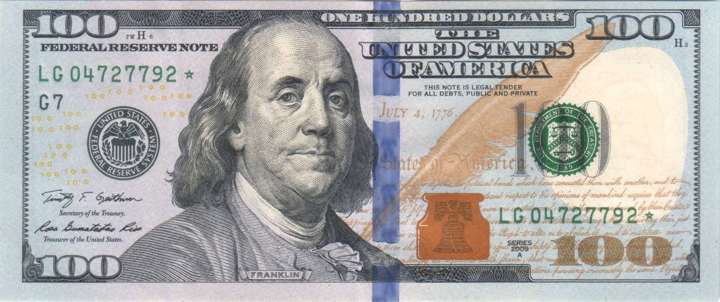
Let’s model a bank ATM (incorrect order)
WOOT!
FREE MONEY
$1000
$1000
$900
TIME
$900
float bal = fetchBalance();
bal -= 100;
dispenceCash(100);
setBalance(bal);
float bal = fetchBalance();
bal -= 100;
dispenceCash(100);
setBalance(bal);

Slide 6
What makes race conditions so nasty?
Was our code “buggy” or flawed?
What was the difference between the correct execution and the incorrect execution?
Clearly there are ATMs that don’t give away money, so what do we do to deal with this?
What about adding some checks to the software to “fix” it?

Slide 7
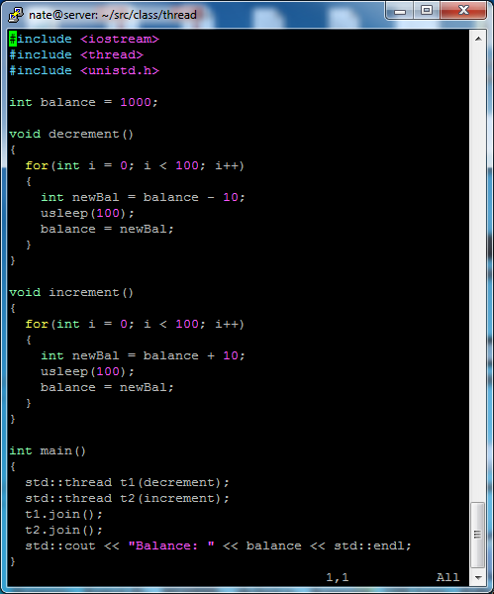
Are there race conditions in this code?
Does this code have logic flaws?
When we run it, what are the results? Why?
What if the sleeps were gone – remember the asm code?
Can you see some sections of code where it is critical to run atomically?

Slide 8
Are there race conditions in this code?
Does this code have logic flaws?
When we run it, what are the results? Why?
What if the sleeps were gone – remember the asm code?
Can you see some sections of code where it is critical to run atomically?

Slide 9
Critical sections
A Critical Section is a code segment that accesses shared variables and has to be executed as an atomic action.
Atomic means executed as a single unit.
  Once started it must complete before any other line of execution can enter
  Makes may lines of code, (which produce many instructions), as if they were a single instruction

Slide 10
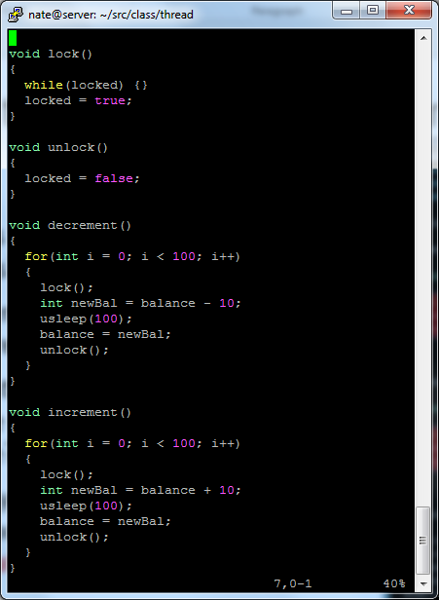
How ‘bout this?
Only allow one thread in the critical section at a time
Did this work?
Where is the race condition now?

Slide 11
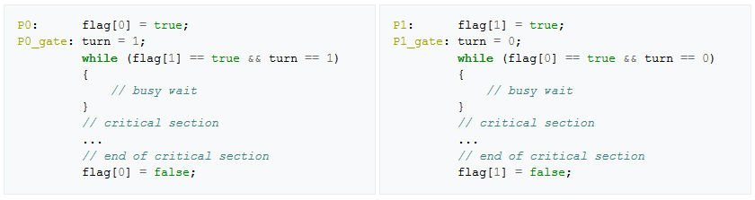
Is there any software solution?
Peterson’s Algorithm
This may be effective
Is it efficient? Why or why not?

Slide 12
Test and set hardware instruction
Atomic assembly instruction which:
  Sets a memory location to ‘1’
  Returns the previous value of the memory location
This can be used to create a spinlock. How?
Why is this called a spinlock?
Can you think of a more efficient way to wait?

